Slide 1
Business License Status Prediction
- - Shashank Awasthi

Slide 2
Problem Statement
Many of us have dreams what if I become the founder of a start-up and can lead it to become a big business-like Microsoft, or Facebook/Amazon. But again, there are many people who cheat people to run their business, probably everyone has heard about cheat-funds. This dataset contains a lot of data and the ‘LICENSE STATUS’ column which depicts whether the person has been able to get a business license or not. Based on the given features you have to predict whether a person will be given a license or not to run his business. The ‘LICENSE STATUS’ contains the following categories:
AAC (license was cancelled during term)
AAI (license was issued)
INQ (license requires inquiry)
REA (license revocation has been appealed)
REV (license was revoked)
We had to predict the column “LICENSE STATUS” and Submit the file in "Output.csv" format.

Slide 3
Methodology
Data preparation
Exploratory data analysis
Data Preprocessing
Feature Engineering
Training Models
Evaluation
Hyperparameter tuning
Retrain the models
Feature Importance

Slide 4
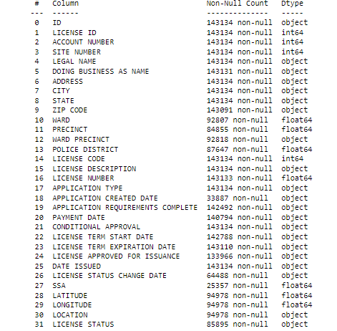
Insights from the dataset
We observe in the dataset that there are Multiple Categorical, Numerical as well as Datetime variables.

Slide 5
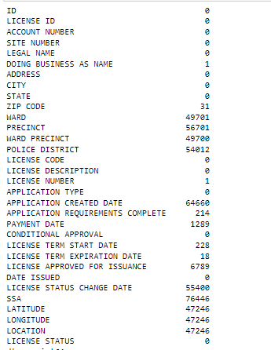
Insights from the dataset
Observing that multiple features present with missing values, some with more than 50%.

Slide 6
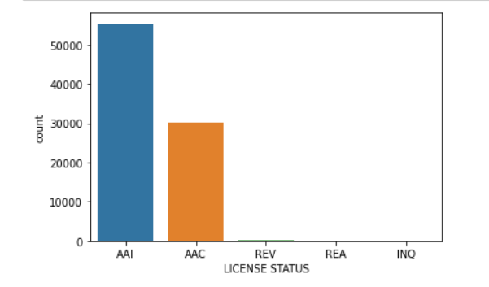
Insights from the dataset
Observing the dataset is highly Imbalanced with AAI and AAC having 99% of data as can be seen here:

Slide 7
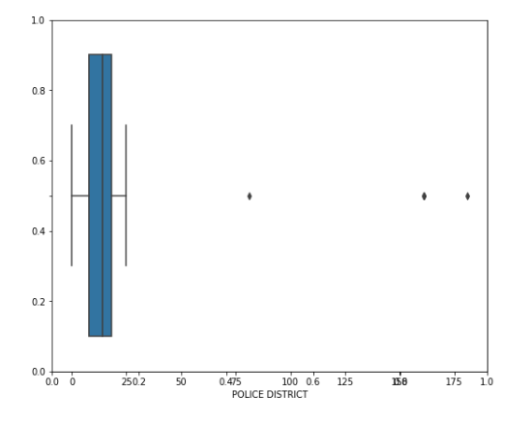
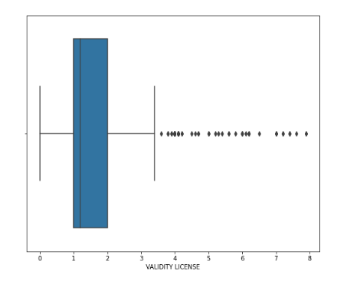
Insights from the dataset
Multiple features present with Outliers

Slide 8
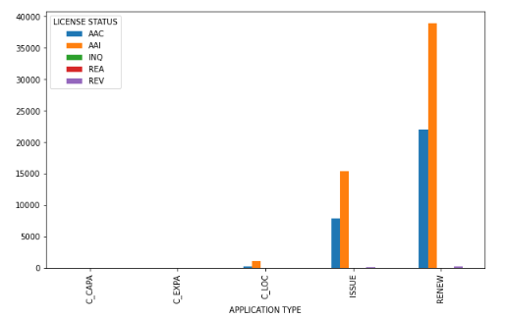
Insights from the dataset
Applying Bivariate analysis and observing few relationship between Features

Slide 9
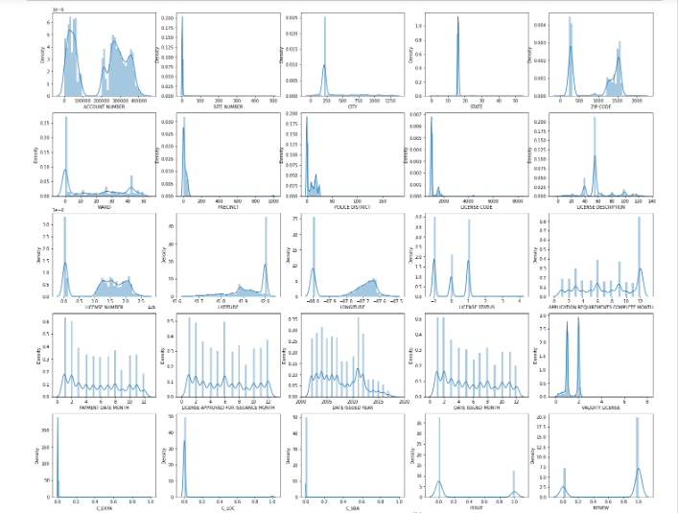
Insights from the dataset
Checking out the univariate distribution of data

Slide 10
Data Preprocessing Steps Taken
Dropping columns which do not add significance to our models such as ID, LICENSE ID, ADDRESS.
Dropping few columns which don’t have much data in them as well as don’t contribute much, or are combination of other features such as SSA, LOCATION, WARD PRECINCT.
Converting Columns with dates to datetime and extracting Years and months and relevant information , before dropping them
Handling Outliers by clipping the anomaly values
Handling Missing data by Single imputation method.

Slide 11
Feature Engineering Steps Taken
Handling Text features with few transformations.
Creating Dummies and label Encoding for Categorical Features
Creating few new features to increase model interpretability.

Slide 12
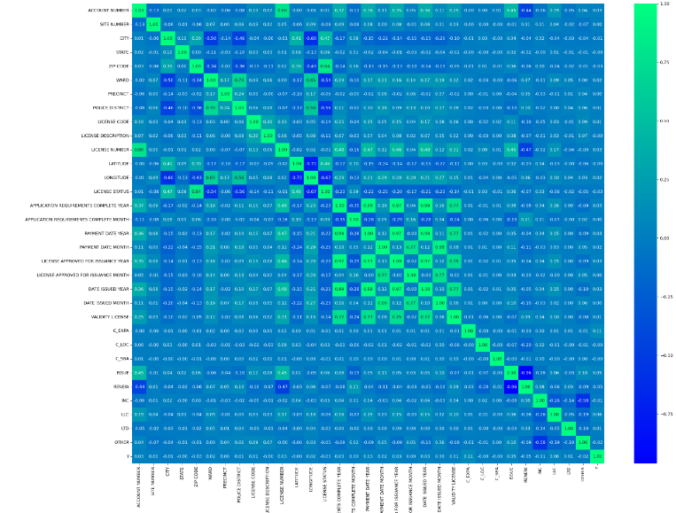
Feature Selection Steps Taken
Finding correlation of the features to check which features impact.

Slide 13
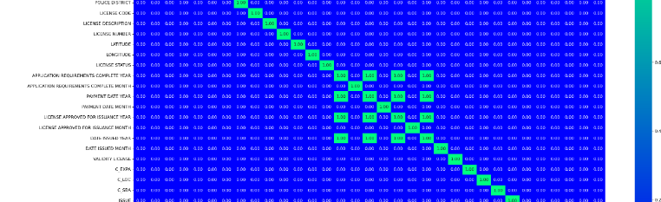
Feature Selection Steps Taken
Removing Multicollinearity as few Features are highly correlated and choosing relevant features :

Slide 14
Feature Selection Steps Taken
Since the dataset is highly imbalanced which could lead to model bias, applying these methods to balance classes:
Under sampling
Over sampling
SMOTE

Slide 15
Training Model to get Baseline Predictions
Training Models to get baseline prediction and more insight of data :
Logistic Regression
KNN
Naïve Bayes
Decision Tree
Random Forest
Cat boost
Xg boost

Slide 16
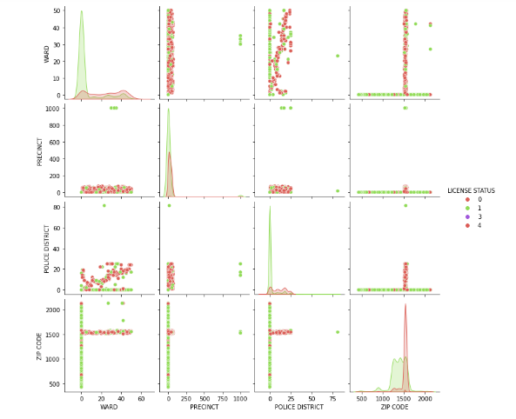
Evaluation / Performance of Model
We observed that Logistic Regression Algorithm is not performing Best as the data is not linearly separable.

Slide 17
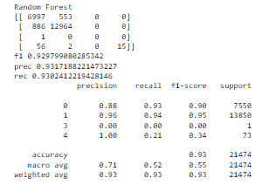
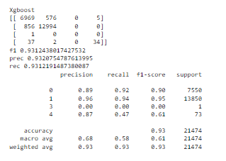
Evaluation / Performance of Model Cont.
Random Forest and XG Boost giving best overall F1 Scores.

Slide 18
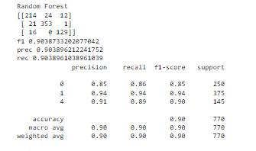
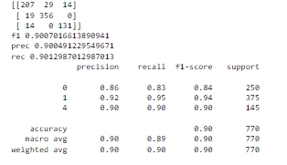
Hyperparameter Tuning
Tuning Random Forest and XG Boost hyperparameters to improve F1 Scores

Slide 19
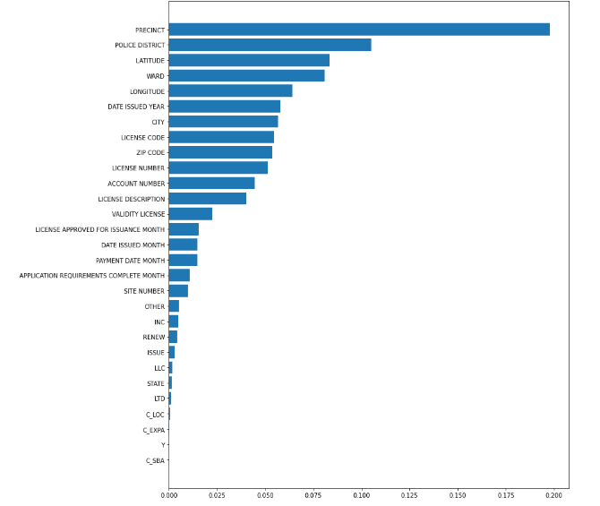
Feature Importance
We observed that ‘Precent’ contributed most to the prediction.

Slide 20
Conclusion
We observed that after balancing the dataset , applying Random Forest and Xg boost and tuning them , we were able to get around 93% F1 score on the validation set. Hence using them to predict for test set.

